Slide 1
Car Management App
Features and Use Cases

Slide 2
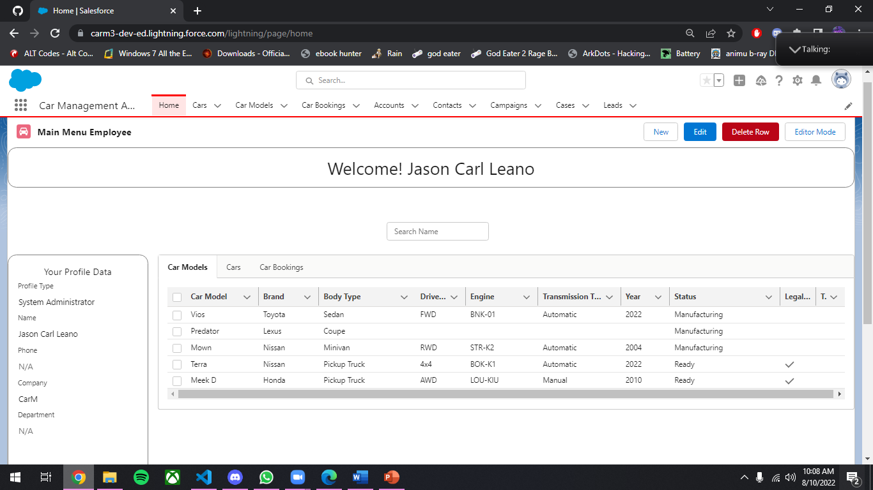
Main Interface for Users Handling Car Management App

Slide 3
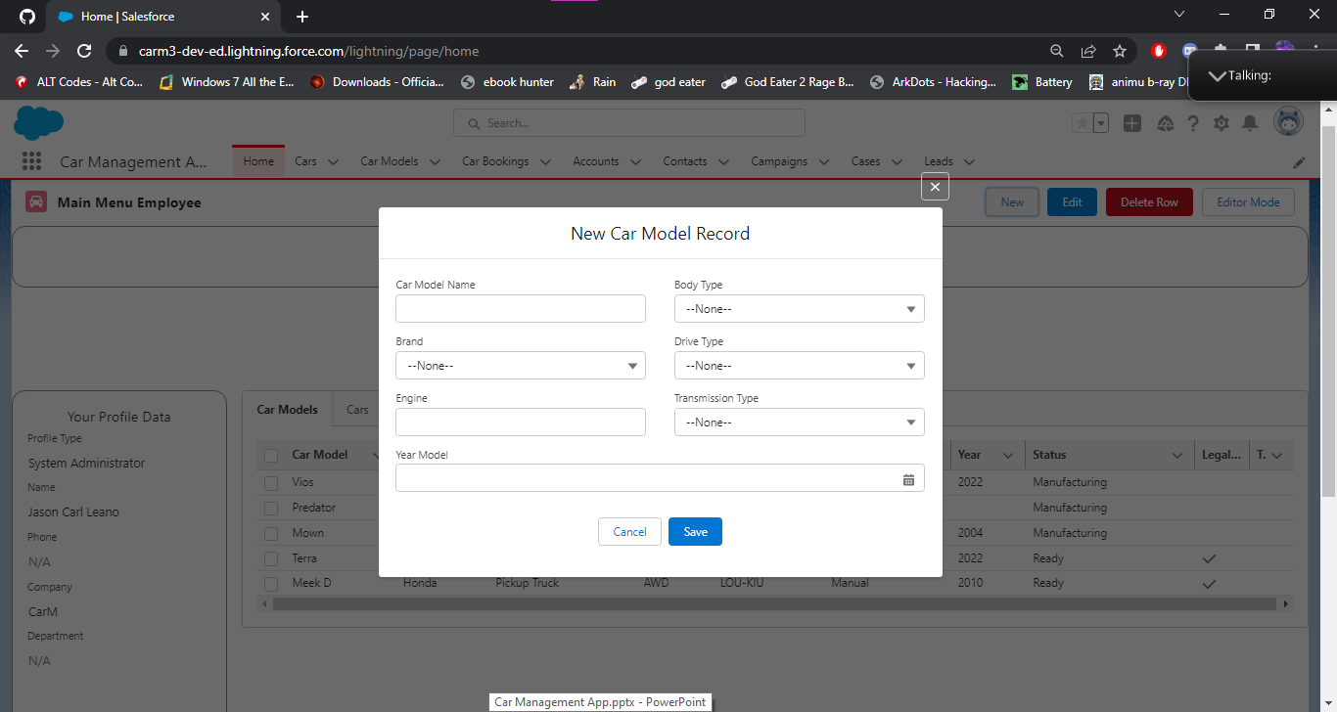
The New Window shows when “New” is pressed.

Slide 4
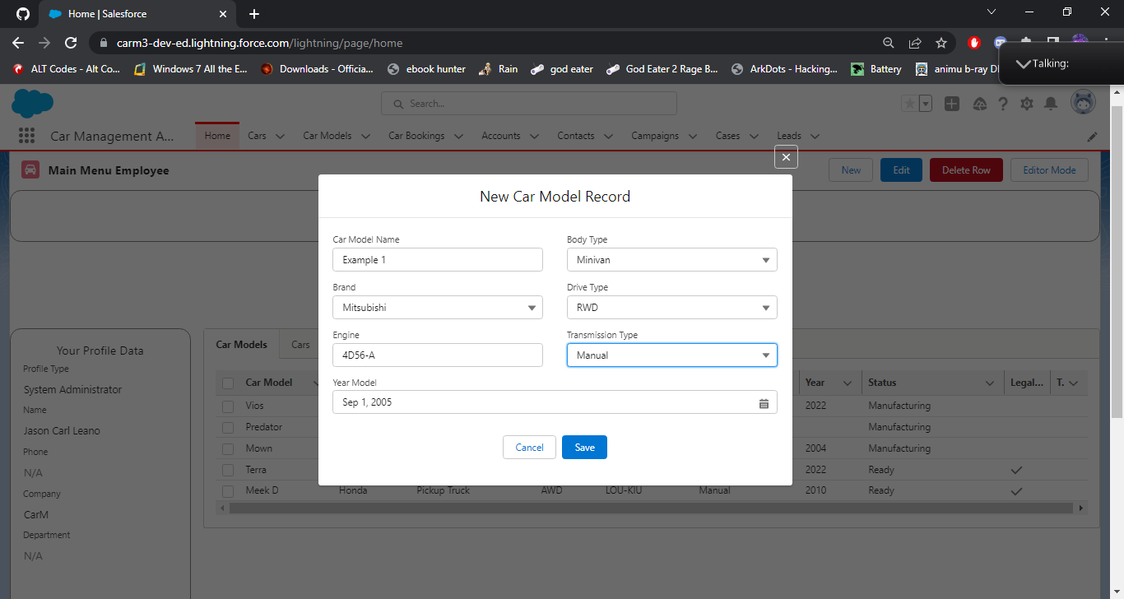
Clicking Save will create new record on Car Model

Slide 5
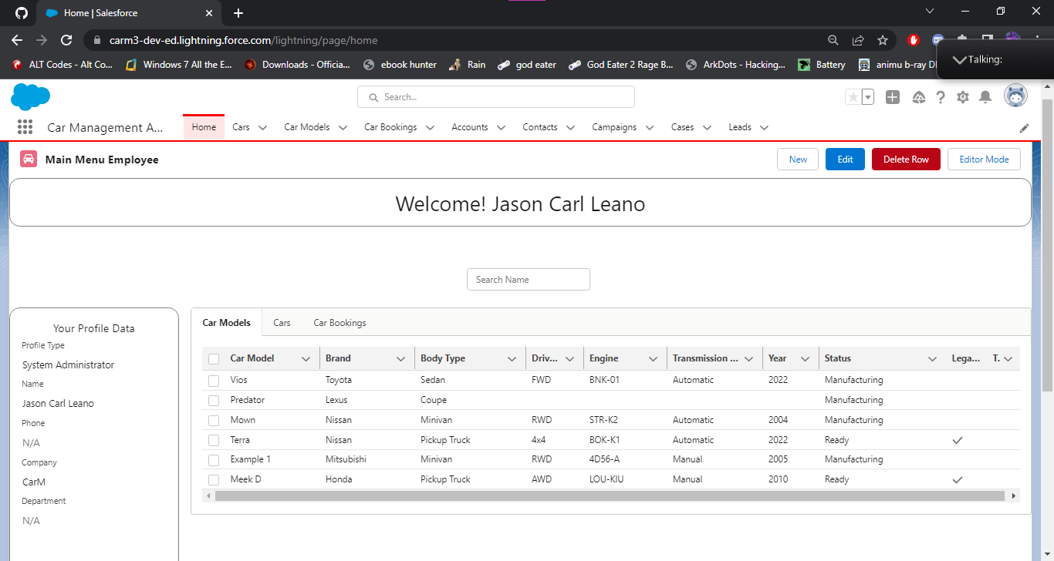
New Car Model Record Created.

Slide 6
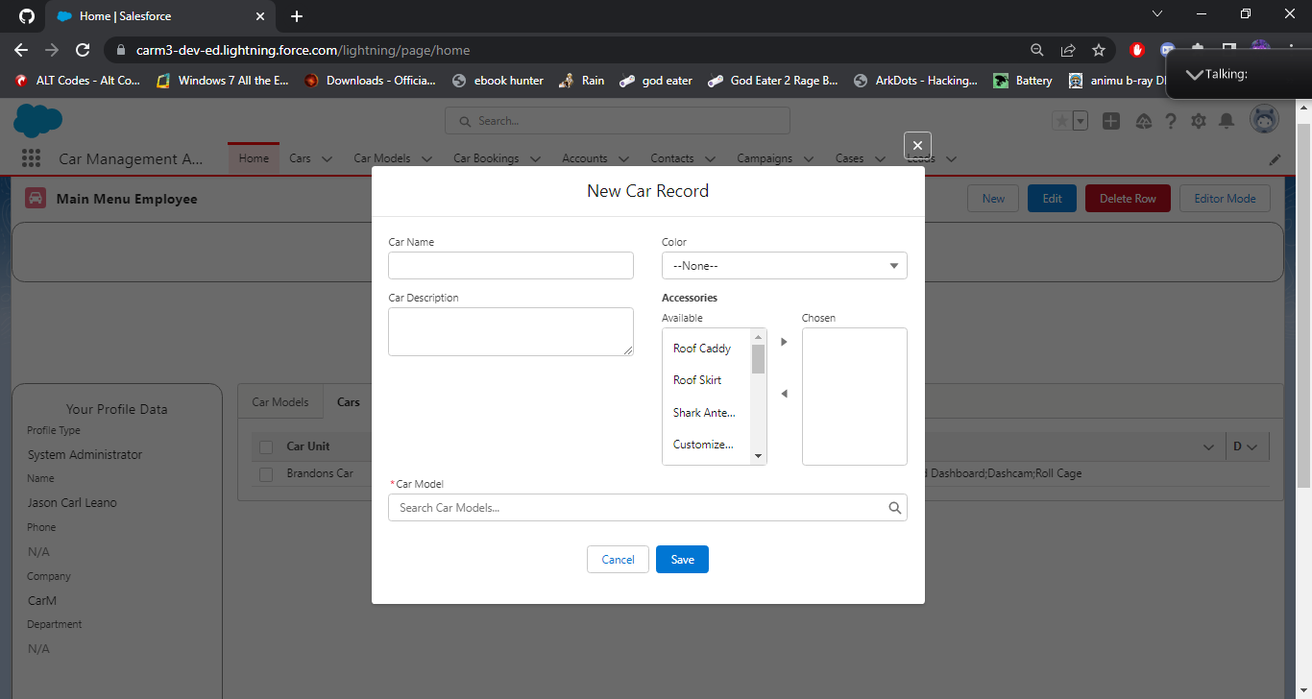
Same with other tabs also linked to New button.

Slide 7
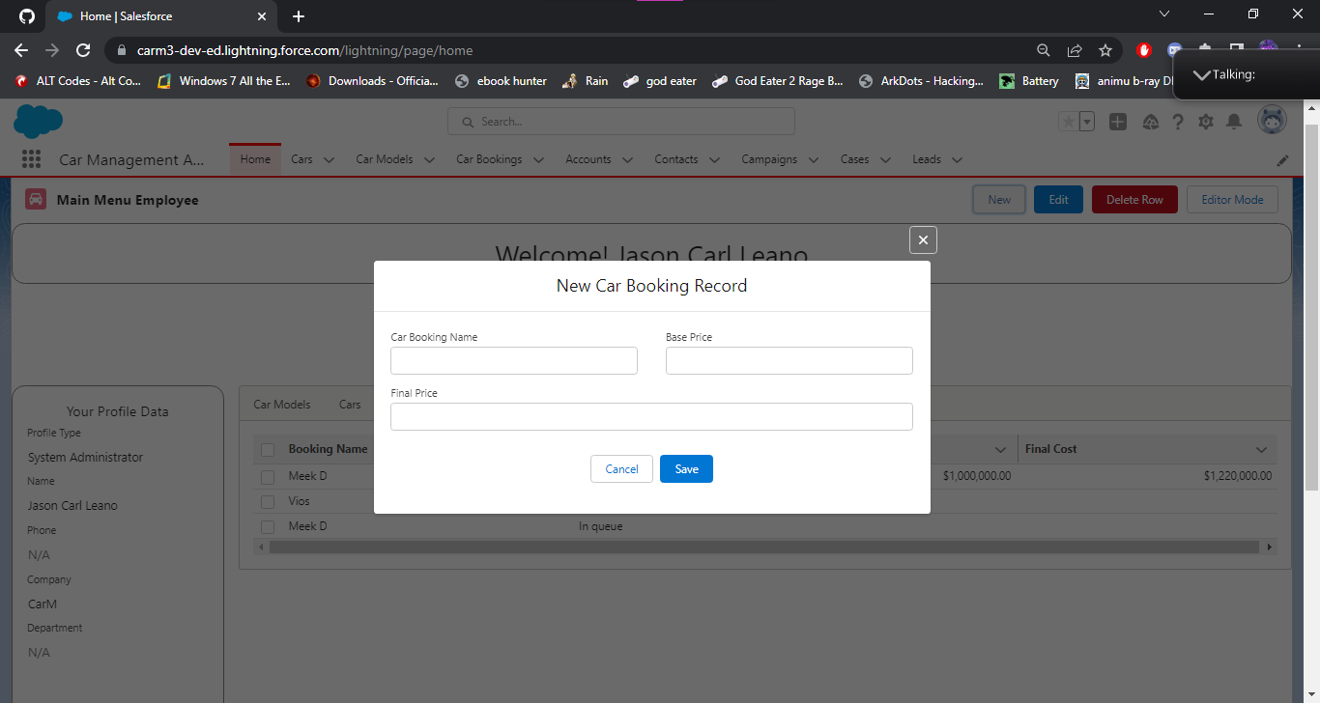
And this is the last for Car related Apps Create Record

Slide 8
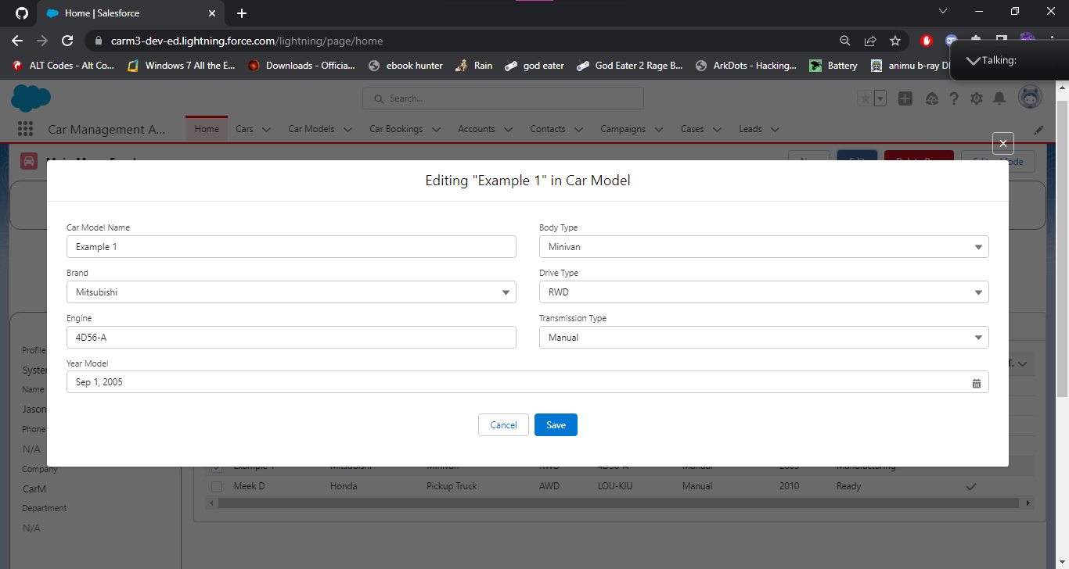
When edit is clicked, it shows like this. It takes account of certain users permissions

Slide 9
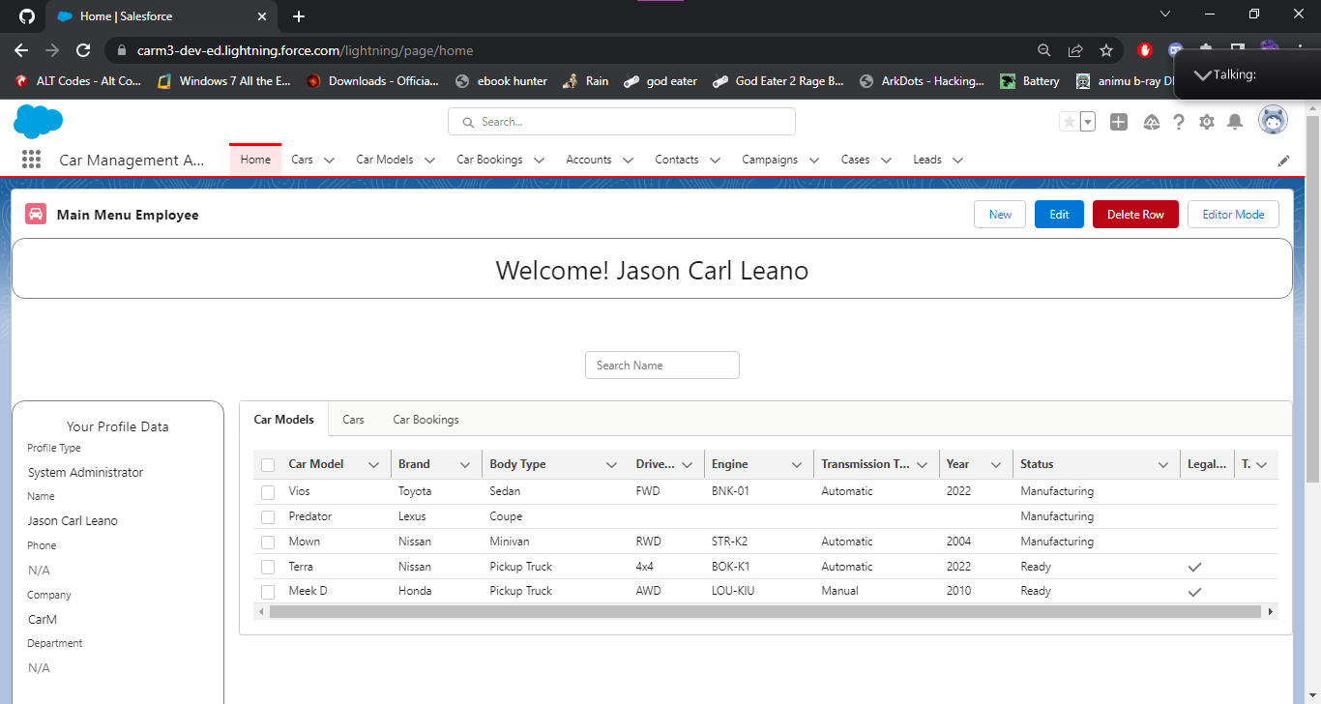
On press of delete row, it will delete all selected rows in current tab.

Slide 10
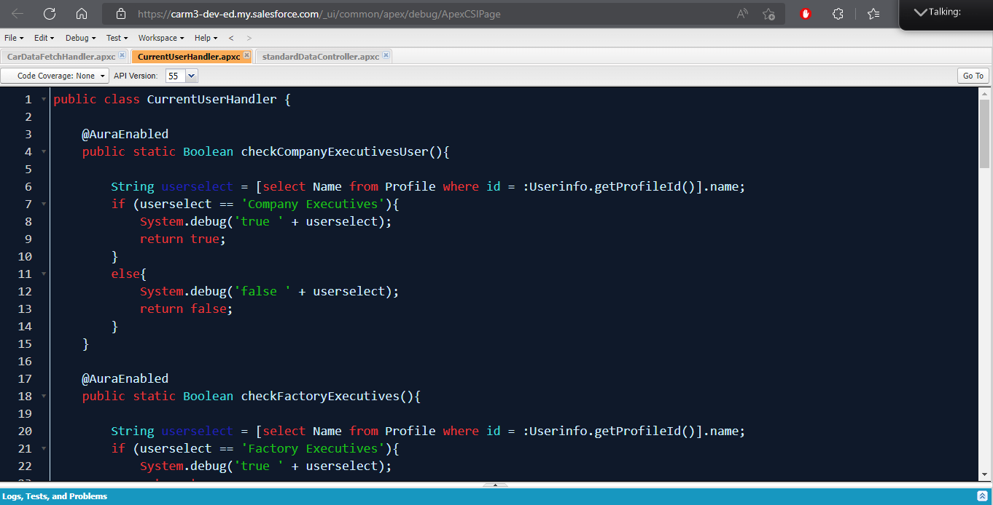
Apex Class for testing what profile it uses.

Slide 11
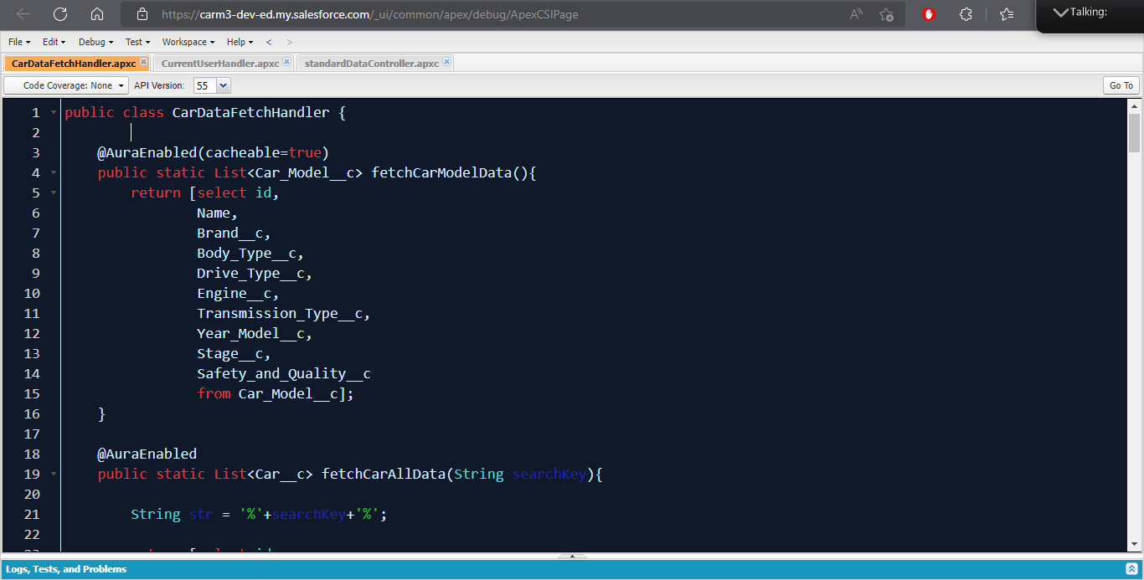
Apex Class for fetching all data needed.

Slide 12
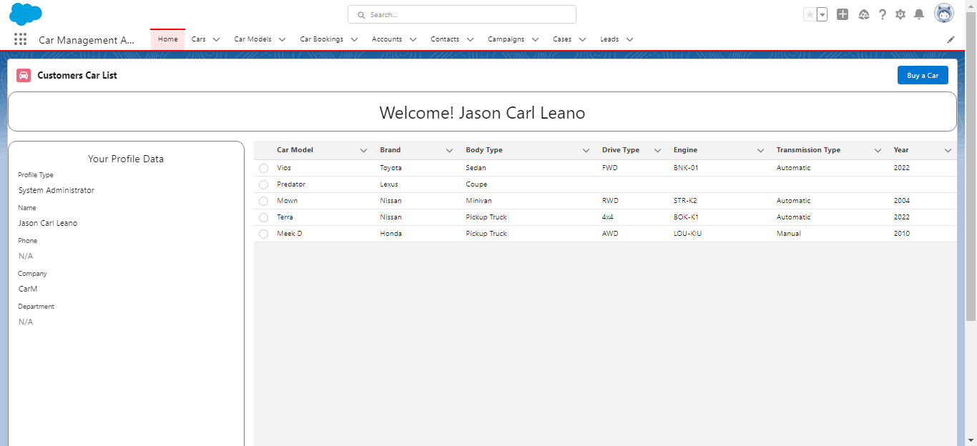
This is the GUI for Customer Model Buy List. Pressing buy creates a new car booking record

Slide 13
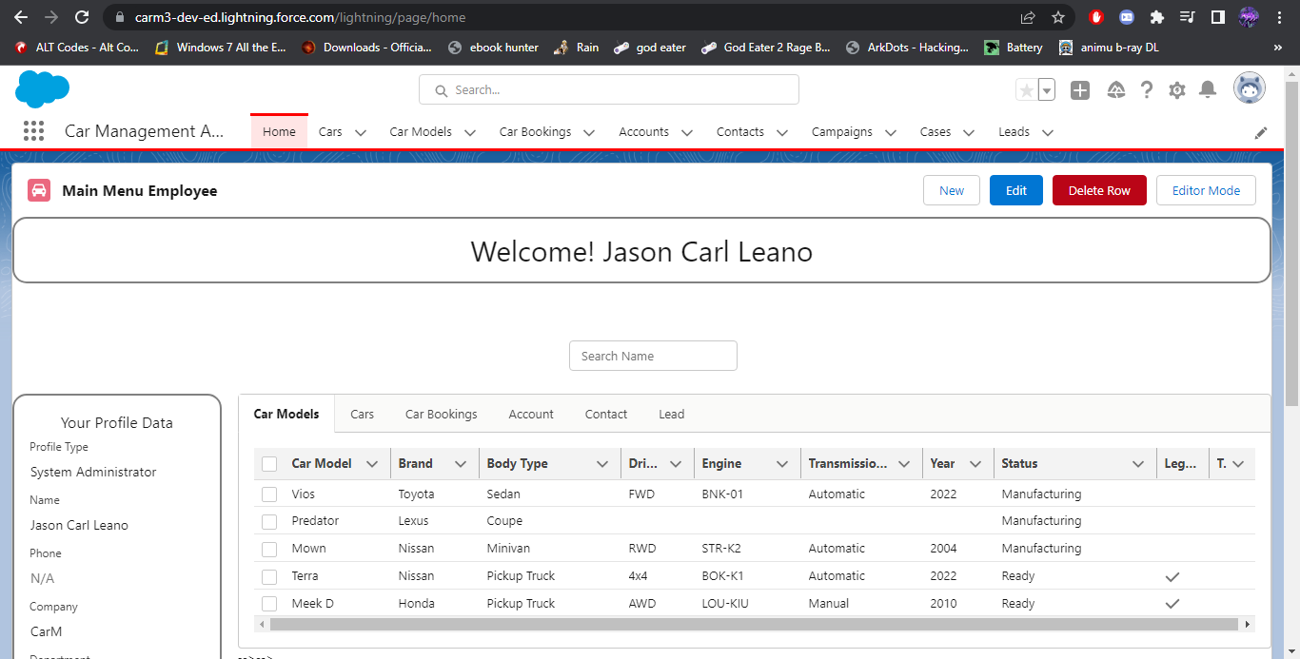
Sales Executive Home GUI, unlocks editor mode and shows account, contact and lead tabs

Slide 14
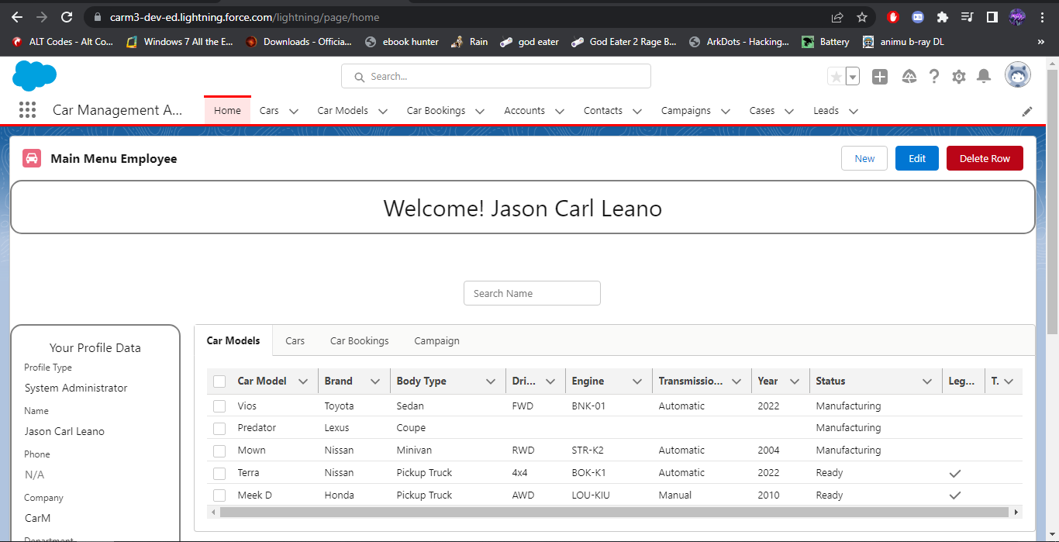
Digital Marketer GUI, it shows Campaigns tab where it can create and run new campaigns

Slide 15
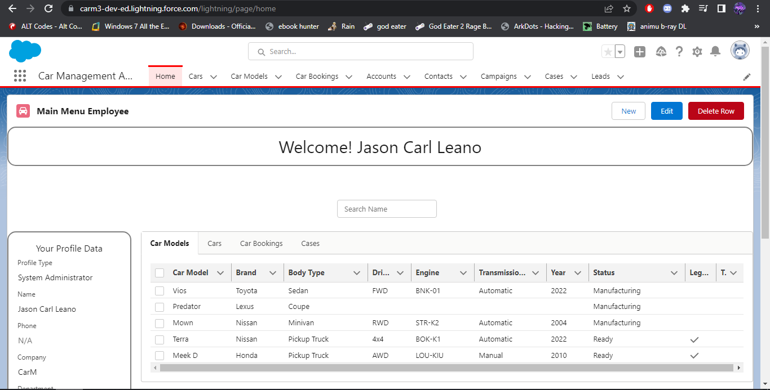
Customer Service Representative GUI, it shows Cases Tab to create new, edit and delete cases

Slide 16
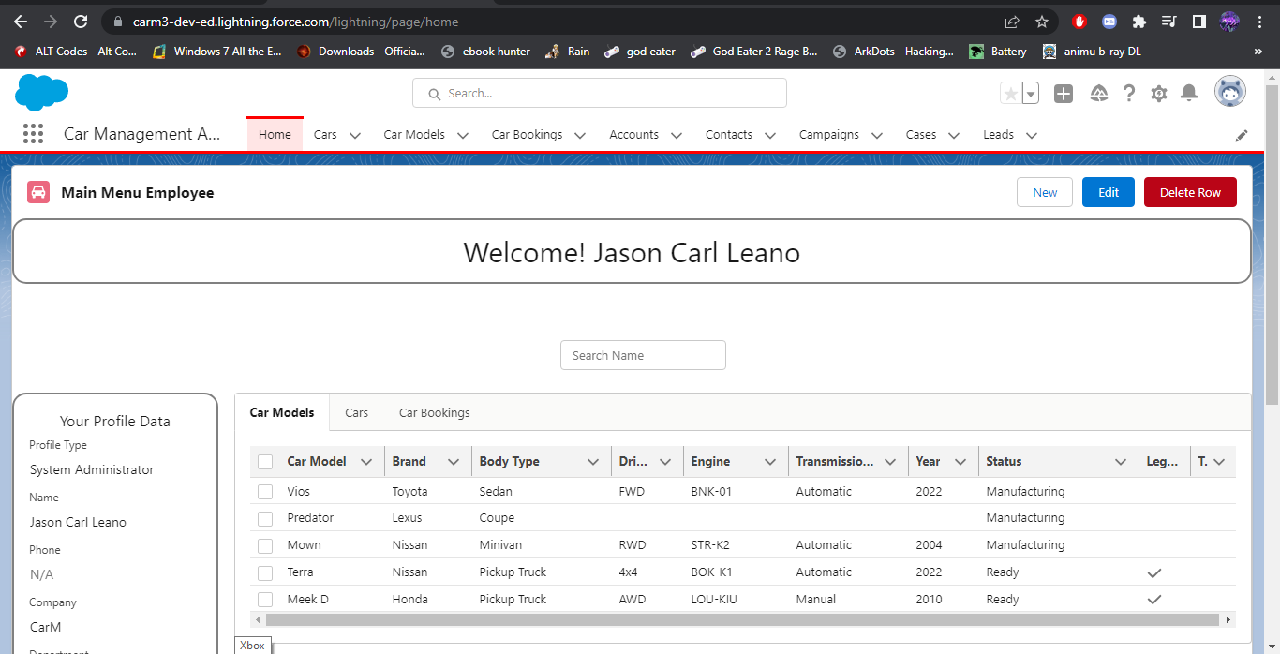
General GUI for Company, Factory, QA, Car Dealer. Record list is sorted via apex class initialization

Slide 17
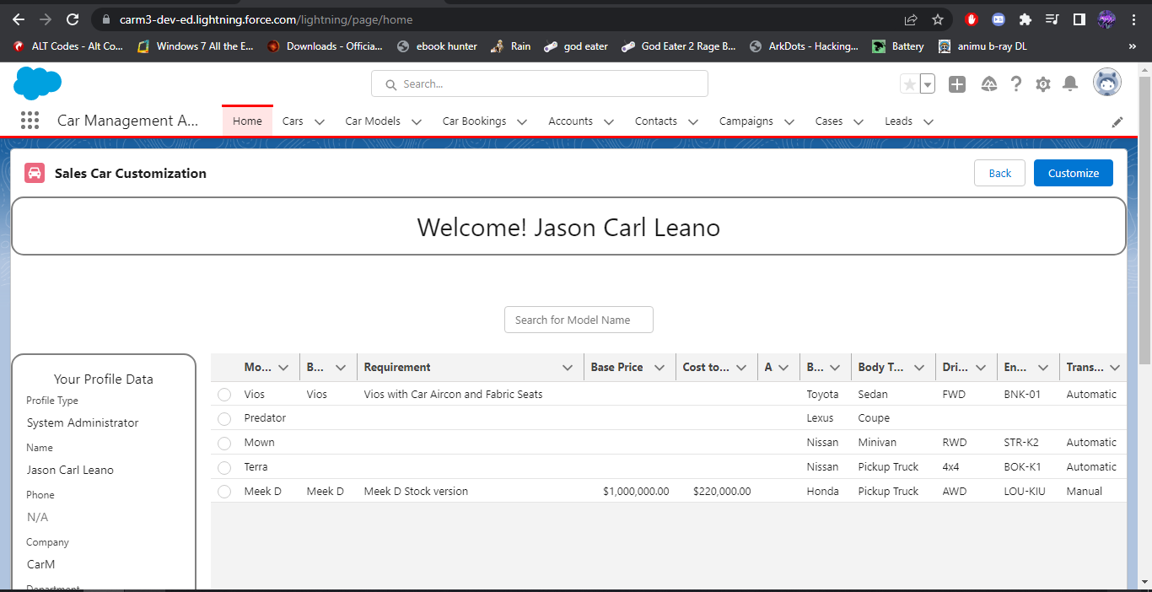
Sales Executive Model Editor to satisfy client requirements and adjust cost.

